Slide 1
Depot Systems 5
Container Yard / Gate Overview

Slide 2
Complete Container Yard / Depot Management System
Gate In, Gate Out, Bookings, Load Manifest
Re-Delivery number support Container or Chassis
Full Maintenance and Repair (M&R) System
Full Reports and Customizable Reports
Full EDI support for all SS Lines and Chassis pools

Slide 3
Optional Add On Modules
Windows Tablet / Hand Held
Rental System, supports containers, chassis, gensets
Driver In Yard / Lift Queue – Track drivers and lift operators. Assign yard tickets.
GPS locations and Lot – parking space numbers

Slide 4
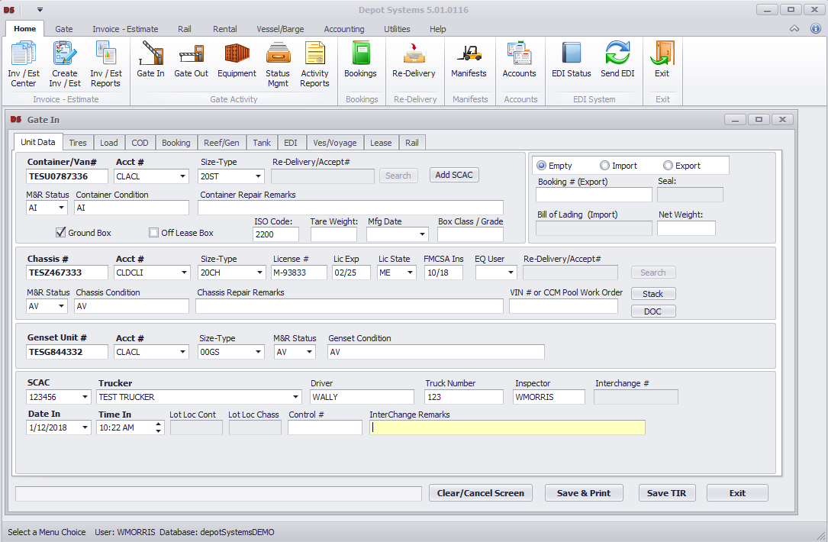
Gate In
Full container, chassis, and genset support. Auto Lifting and Auto separation of pool chassis. Fully supports empty, loads, reefers, tanks, and container leasing companies.

Slide 5
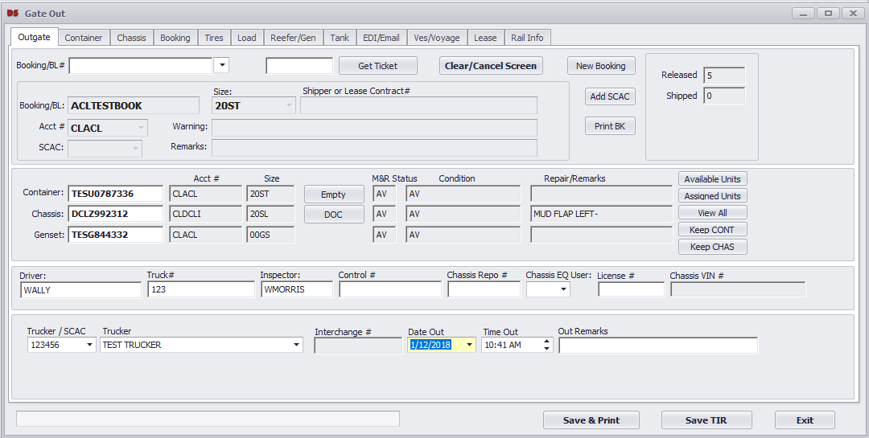
Gate Out
Full container, chassis, and genset support. Auto Mounting Equipment and Auto Mounting of pool chassis. Many safety checks to prevent equipment from gating out if not in good order or other conditions.

Slide 6
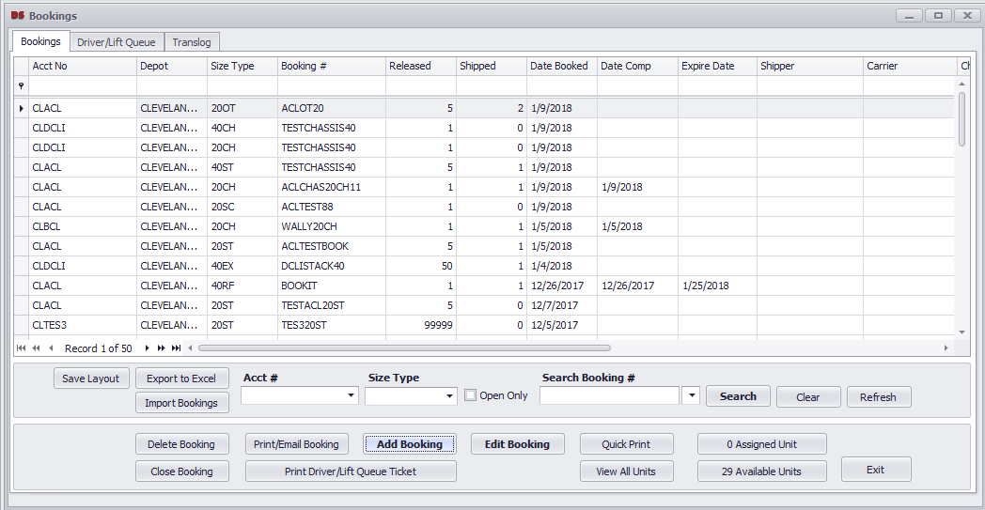
Bookings
Full Booking support for steamship line releases or internal releases. Supports multiple size types and expiation dates. Allows equipment assignment to bookings.. Full 301 EDI support for SS Line booking feeds

Slide 7
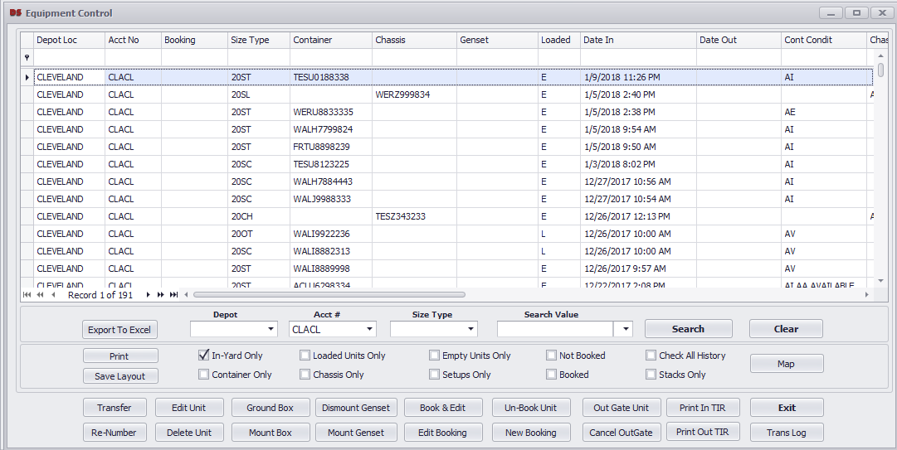
Equipment
Easily search and manage your equipment. The Equipment system lets you lift, mount and edit units. Interchange prints and equipment status can be done from here.

Slide 8
Re-Delivery
Leasing company or chassis pool delivery numbers are handled in the Re-Delivery system. This provides control to allow what units can Gate In and how many.

Slide 9
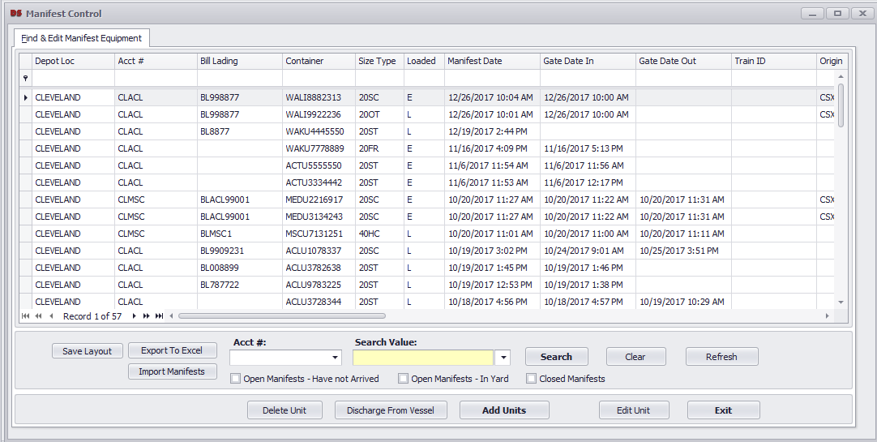
Manifest
Loaded or empty equipment can be entered or imported into the Manifest system. As units gate in, the system will use the manifest info for clearance and pulls in the load details of BL, weight, seal, into the Gate In

Slide 10
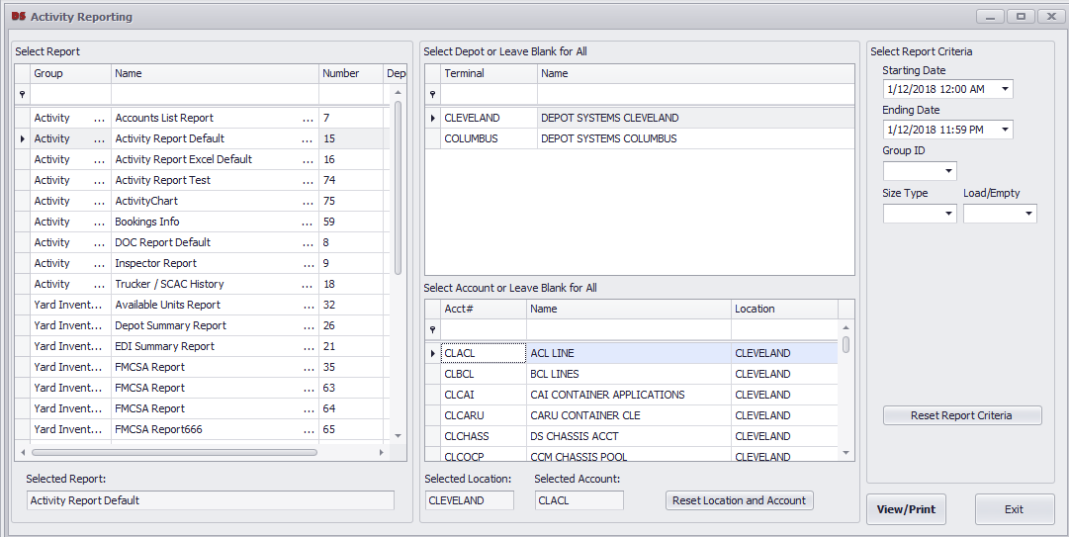
Reporting
Depot Systems 5 contains full reporting, many standard reports are included, custom reports can be created at anytime. Report Scheduling service can be used to schedule any report to send via email. PDF and Excel formats are supported.

Slide 11
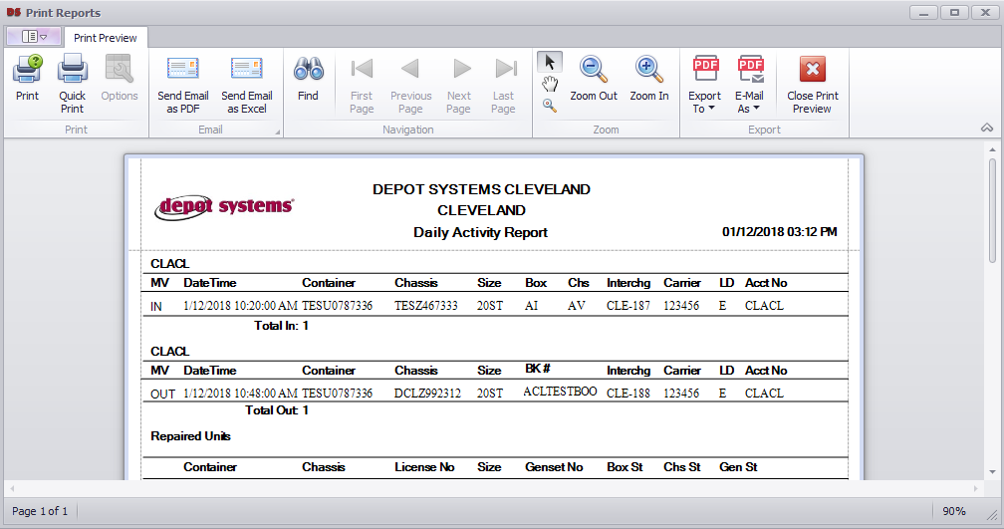
Report Printing & email
All reports will print to a preview window, then you can choose to print, email, or export to local file.

Slide 12
EDI
EDI will auto send for Gate In/ Out within 10 minutes of the gate transaction.
Booking EDI will auto load into the system every 5-10 minutes.
See our web site for a full list of supported EDI formats and SS Line / Chassis pool support.

Slide 13
What's Next?
Please see our other PowerPoint presentations for the Windows Tablet App to support the PC gate system.
Please see our other PowerPoint presentations for the M&R system for repairing equipment.
Contact Depot Systems to get a full trial system.

Slide 14
depotsystems.com

